Slide 1
Differential calculus

Slide 2
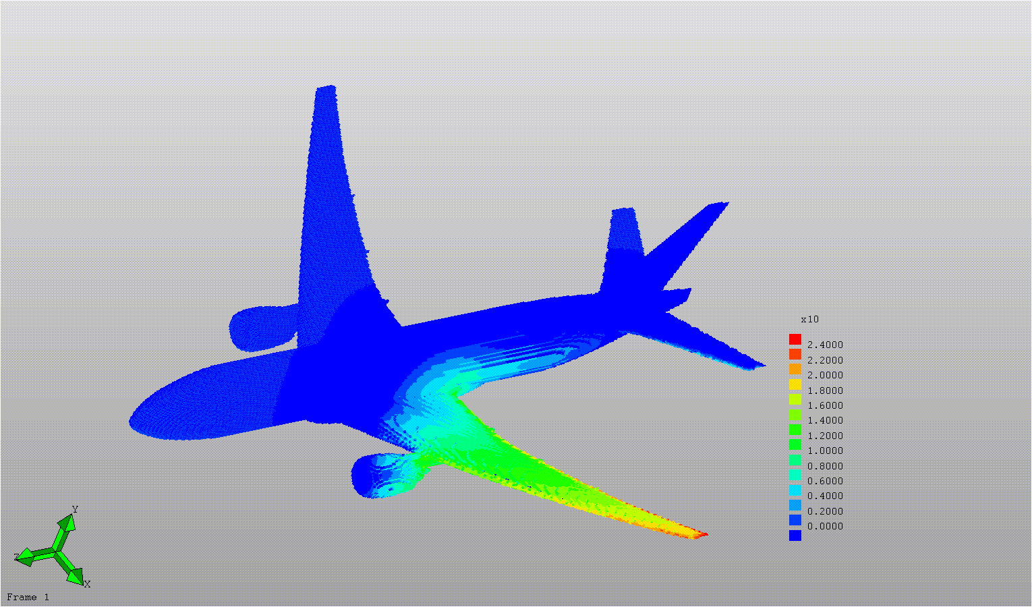

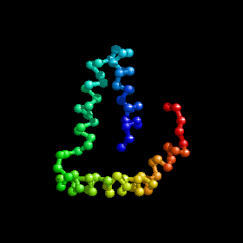
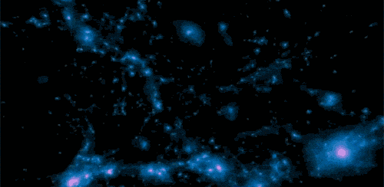

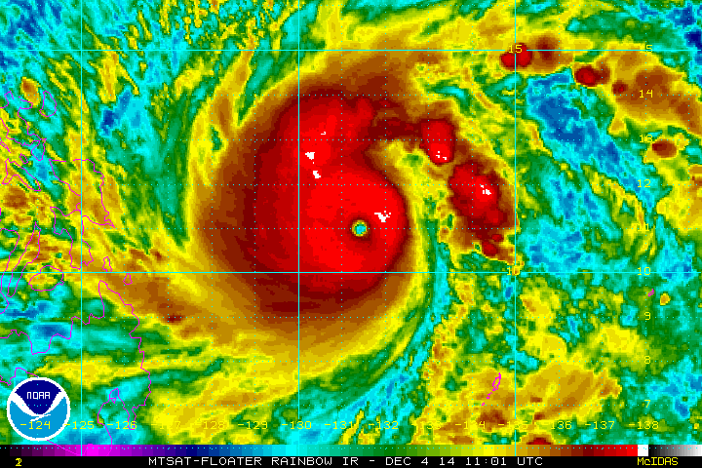
Computational modeling
A computational model is a computational instantiation of a mathematical model that simulates the behavior of a system in order to study said system.
The system under study is often a complex nonlinear system for which simple, intuitive analytical solutions are not readily available.
Experimentation with the model is often done by adjusting the parameters of the system in the computer, and studying the differences in the outcome of the experiments.
Operation theories of the model can be derived/deduced from these computational experiments.
Examples of common computational models are weather forecasting, pharmacokinetics, flight simulators, molecular protein folding, biological systems, financial modeling, and neural network models.
The dynamics of complex systems are often described with differential equations

Slide 3
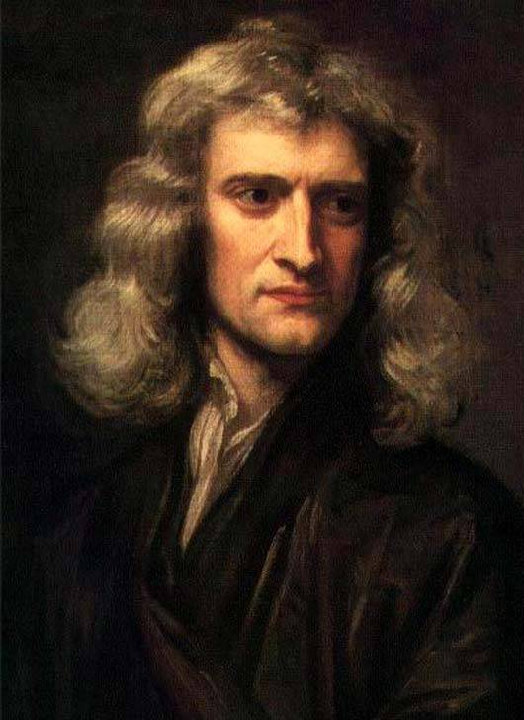
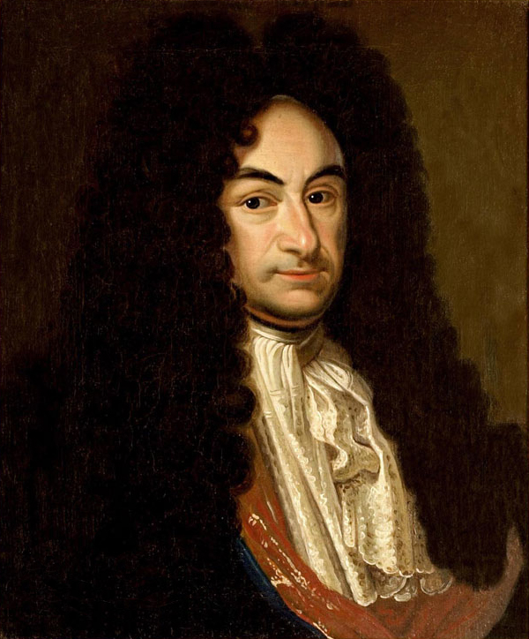
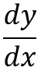
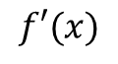
Overview
Calculus is the study of how things change
Calculus provides a framework for
Computational modeling of systems in which there is change (i.e. predict)
Optimization
The derivative informs the way a function can be optimized (maximized, minimized)
An enormous chunk of the modern technological edifice rests on the tools of calculus
$$f′(x)$$
Issac Newton
$$\frac{dy}{dx}$$
Gottfried Wilhelm von Leibniz
Notes:
Calculus provides a way for us to construct relatively simple quantitative models of change, and to deduce their consequences.
With this you get the ability to find the effects of changing conditions on the system being investigated. By studying these, you can learn how to control the system to do make it do what you want it to do. Calculus, by giving engineers and you the ability to model and control systems gives them (and potentially you) extraordinary power over the material world.
The development of calculus and its applications to physics and engineering is probably the most significant factor in the development of modern science beyond where it was in the days of Archimedes. And this was responsible for the industrial revolution and everything that has followed from it including almost all the major advances of the last few centuries.
Differential calculus determines the rate of change of a quantity
Integral calculus finds the quantity where the rate of change is known

Slide 4
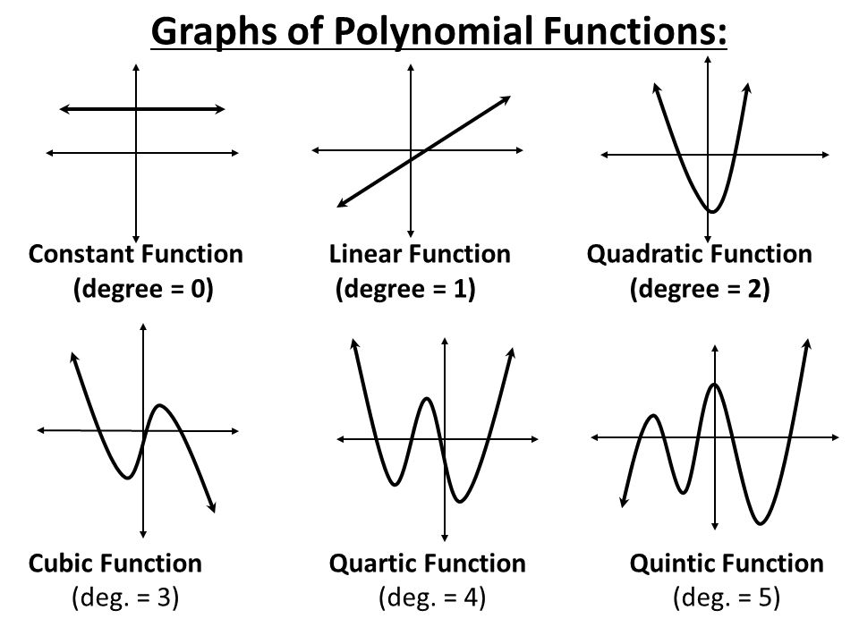
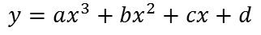
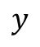
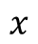
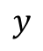
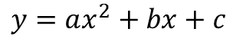
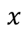
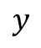
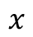
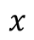
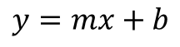
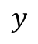
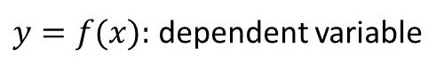
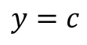
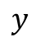
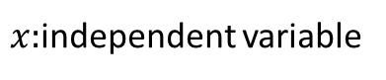
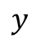
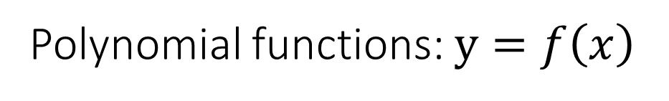
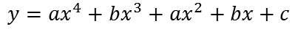
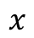
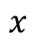
Polynomial functions: $y=f\left(x\right)$
$x:$independent variable
$y=f(x):$ dependent variable
$$y$$
$$y$$
$$y$$
$$x$$
$$x$$
$$x$$
$$y=c$$
$$y=mx+b$$
$$y=ax^{2}+bx+c$$
$$y$$
$$y$$
$$y$$
$$x$$
$$x$$
$$x$$
$$y=ax^{3}+bx^{2}+cx+d$$
$$y={ax}^{4}+bx^{3}+ax^{2}+bx+c$$
$$y={ax^{5}+bx}^{4}+cx^{3}+dx^{2}+ex+f$$
Notes:
Mathematical functions are a useful abstraction to describe physical phenomena
The degree of a polynomial determines the complexity of the phenomena that it can describe
The parameters of the polynomial adjust its behavior

Slide 5
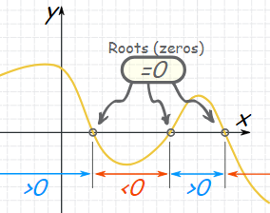
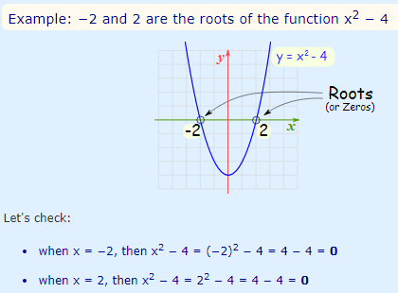
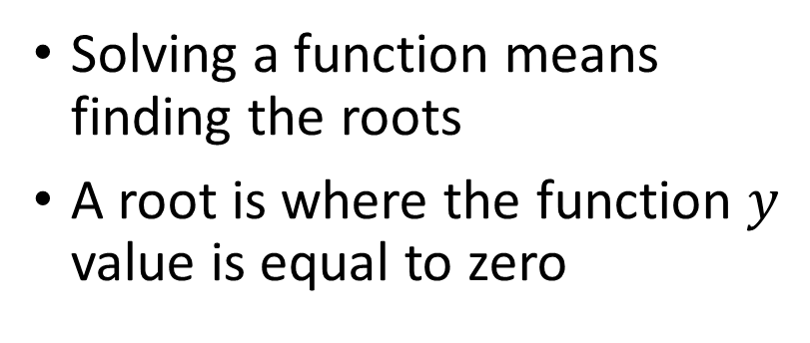
Finding the roots/solutions of a polynomial function
Solving a function means finding the roots
A root is where the function $y$ value is equal to zero

Slide 6
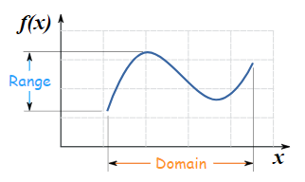
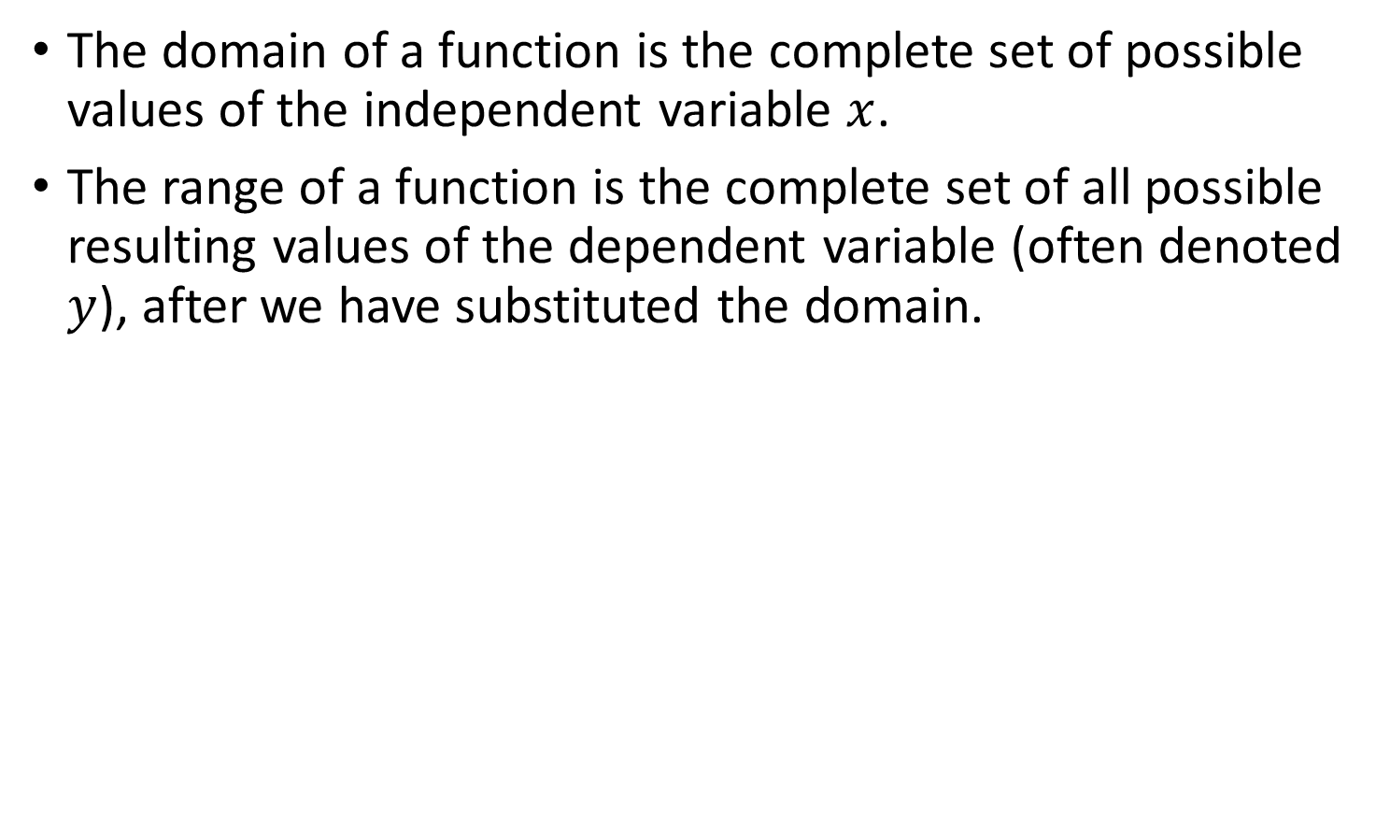
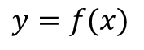
Domain and range of a function
The domain of a function is the complete set of possible values of the independent variable $x$.
The range of a function is the complete set of all possible resulting values of the dependent variable (often denoted $y$), after we have substituted the domain.
$$y=f(x)$$

Slide 7
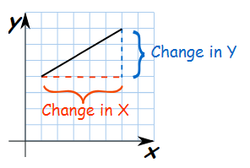
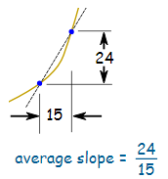
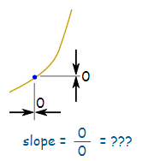
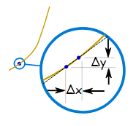
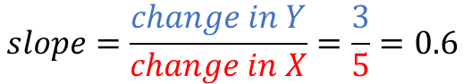
Slope
$$slope=\frac{change in Y}{change in X}=\frac{3}{5}=0.6$$
The slope is a number that describes both the direction and the steepness of a line
It is easy to find the average slope between two points
But how do we find the slope at a point?
we use changes in x and y that shrink towards zero (change at the limit)
Visualizing the slope of a function at a point:
https://www.mathsisfun.com/calculus/slope-function-point.html

Slide 8
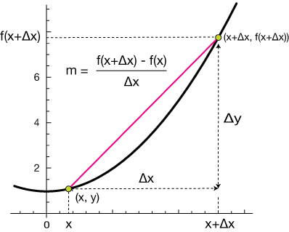
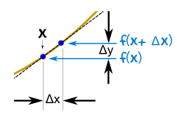
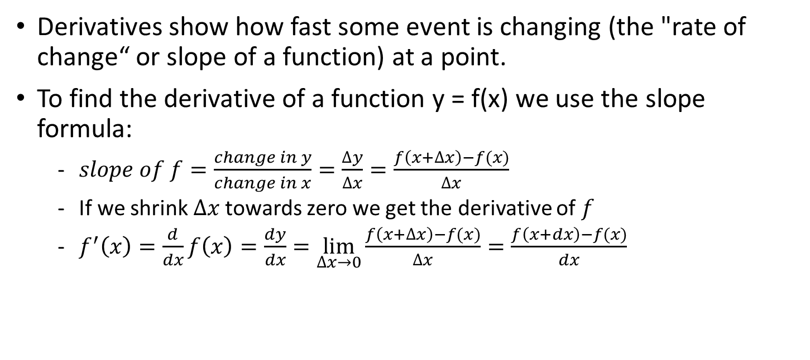
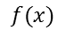
Introduction to derivatives
Derivatives show how fast some event is changing (the "rate of change“ or slope of a function) at a point.
To find the derivative of a function y = f(x) we use the slope formula:
$slope of f=\frac{change in y}{change in x}=\frac{∆y}{∆x}=\frac{f\left(x+∆x\right)−f(x)}{∆x}$
If we shrink $∆x$towards zero we get the derivative of $f$
$f^{′}\left(x\right)=\frac{d}{dx}f\left(x\right)=\frac{dy}{dx}=\lim_{∆x→0}{\frac{f\left(x+∆x\right)−f(x)}{∆x}}=\frac{f\left(x+dx\right)−f(x)}{dx}$
$$f(x)$$

Slide 9
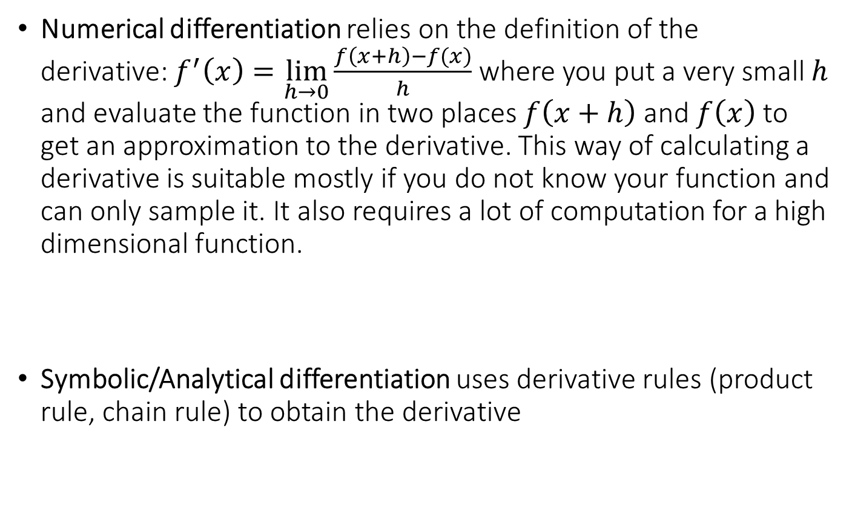

2 popular methods to calculate the derivative
Numerical differentiation relies on the definition of the derivative: $f^{′}\left(x\right)=\lim_{h→0}{\frac{f\left(x+h\right)−f(x)}{h}}$ where you put a very small $h$ and evaluate the function in two places $f\left(x+h\right)$ and $f\left(x\right)$ to get an approximation to the derivative. This way of calculating a derivative is suitable mostly if you do not know your function and can only sample it. It also requires a lot of computation for a high dimensional function.
Symbolic/Analytical differentiation uses derivative rules (product rule, chain rule) to obtain the derivative
$$f\left(x\right)=3x^{2}→f′\left(x\right)=6x$$
Notes:
A third method to calculate the derivative is Automatic differentiation: manipulates blocks of computer programs. A differentiator has the rules for taking the derivative of each element of a program. It uses the chain rule to break complex expressions into simpler ones. You might think that Automatic differentiation is the same as Symbolic differentiation (in one place they operate on math expression, in another on computer programs). And yes, they are sometimes very similar. But for control flow statements (`if, while, loops) the results can be very different:
symbolic differentiation leads to inefficient code (unless carefully done) and faces the difficulty of converting a computer program into a single expression

Slide 10
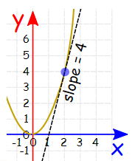
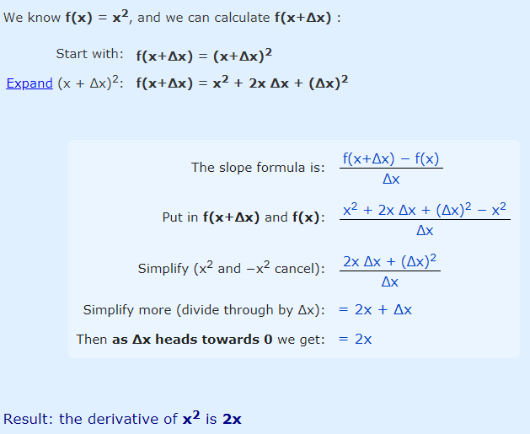
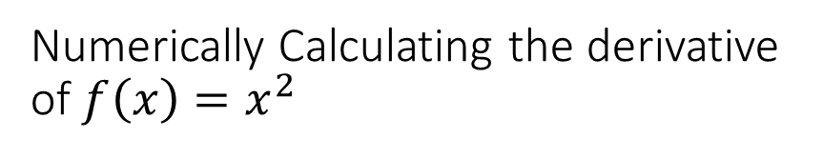
Numerically Calculating the derivative of $f\left(x\right)=x^{2}$
Notes:
Derivatives of Other Functions: We can use the same method to work out derivatives of other functions (like sine, cosine, logarithms, etc).
But in practice the usual way to find derivatives is to use: derivative rules

Slide 11
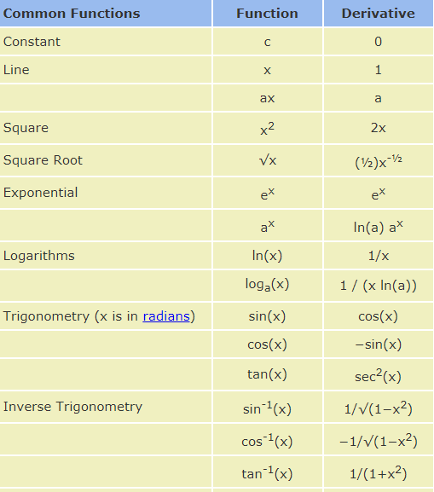
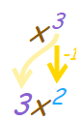



Derivative rules for symbolic differentiation
There are rules we can follow to find many derivatives.
$$f\left(x\right)=$$
$$f^{′}(x)=\frac{df}{dx}=$$

Slide 12


What does $f^{′}\left(x\right)=\frac{d}{dx}x^{2}=2x$ mean?
It means that, for the function $f\left(x\right)=x^{2}$, the slope/derivative/$f′(x)$ or "rate of change" at any point is $2x$.
when x=-2 the slope is 2x = -4
when x=-1 the slope is 2x = -2
when x=0 the slope is 2x = 0
So when x=1 the slope is 2x = 2
So when x=2 the slope is 2x = 4
when x=5 the slope is 2x = 10
Derivative plotter:
https://www.mathsisfun.com/calculus/derivative-plotter.html

Slide 13

Second derivative
A derivative basically gives you the slope of a function at any point.
The "Second Derivative" is the derivative of the derivative of a function. So:
Find the derivative of a function
Then take the derivative of that
A derivative is often written: $f′(x)$ or $\frac{dy}{dx}$
The second derivative is written: $f′′(x)$ or $\frac{d^{2}y}{dx^{2}}$
Example, let’s say
$f\left(x\right)={3x}^{2}$
$f′\left(x\right)=6x$
$f′′\left(x\right)=6$

Slide 14











An analogy of derivatives to physical phenomena: Displacement, velocity and acceleration
Displacement or distance is how far you have moved along a path
$t=time$
$s=f(t)$
For example 50m
Velocity or speed is how much your distance changes over time
$v=f^{′}\left(t\right)=\frac{ds}{dt}=velocity$
For example 10m/s
Acceleration is how much your velocity changes over time
$f^{′′}\left(t\right)=\frac{d^{2}s}{dt^{2}}=\frac{dv}{dt}=acceleration$
For example 2m/s²
$$s$$
$$f(t)$$
$$t$$
$$v$$
$$f′(t)$$
$$t$$
$$a$$
$$f′′(t)$$
$$t$$
Second derivative plotter: https://www.mathsisfun.com/calculus/second-derivative.html

Slide 15


Visualization of a derivative
Notes:
By en:User:Dino, User:Lfahlberg (English Wikipedia) [CC BY-SA 3.0 (http://creativecommons.org/licenses/by-sa/3.0)], via Wikimedia Commons

Slide 16

Finding Maxima and Minima using Derivatives
An important application of derivatives is in optimization problems (maximization or minimization problems)
A maximum is a high point and a minimum is a low point of a function
In a smoothly changing function a maximum or minimum is always where the function flattens out (except for a saddle point).
Where does it flatten out? Where the slope is zero.
Where is the slope zero? When the Derivative is zero!

Slide 17

How Do We Know it is a Maximum (or Minimum)?
Derivatives come to the rescue again.
As long as the function is differentiable
This technique would not work with 𝑓(𝑥)=|𝑥|
Second Derivative Test
Take the derivative of the slope (the second derivative of the original function)
When a function's slope is zero at x, and the second derivative at x is:
less than 0, it is a local maximum
greater than 0, it is a local minimum
equal to 0, then the test fails (there may be other ways of finding out though)

Slide 18




Second Derivative Test visualization
$$f(x)$$
$$f′(x)$$
Super important!!!
Notice how the derivative $f′(x)$ is 0 at local minimum/maximum of $f(x)$
So you can find minimum/maximum of $f(x)$ by finding the roots of $f′(x)$
Notice how the 2nd derivative $f′′(x)$ is positive at local minimum and negative at local maximum
So you can determine whether the roots of $f^{′}\left(x\right)$ are minima or maxima
$$f′′(x)$$

Slide 19











Finding maximum and minimum of a function using the derivatives
$$y=f\left(x\right)=2x^{3}−9x^{2}+12x+6$$
$$f′\left(x\right)=6x^{2}−18x+12$$
$$f′′\left(x\right)=12x−18$$
Setting the first derivative $f^{′}\left(x\right)=0$:
$6x^{2}−18x+12=0$
$x^{2}−3x+2=0$
$(x−2)(x−1)=0$
The two roots at which $f^{′}\left(x\right)=0$ are therefore $x=2$ and $x=1$
For $x=2$:
For $x=1$:
$$f\left(2\right)=2×2^{3}−9×2^{2}+12×2+6=10$$
$$f\left(1\right)=2×1^{3}−9×1^{2}+12×1+6=11$$
$$f^{′}(2)=6{×2}^{2}−18×2+12=0$$
$$f^{′}(1)=6{×1}^{2}−18×1+12=0$$
$$f^{′′}(2)=12×2−18=6$$
$$f^{′′}(1)=12×1−18=−6$$

Slide 20
Modeling algorithms for computational simulations

Slide 21


Differential equations introduction
In our world things change, and describing how they change often ends up as a Differential Equation
A Differential Equation is an equation with a function and one or more of its derivatives
Example: an equation with the function $y$ and its derivative $\frac{dy}{dx}$
We solve a differential equation when we discover the function $y$
So we can model a phenomena $y$ as a function of its rate of change and additional constraints
Mathematicians still don’t know how to solve many types of differential equations

Slide 22

Why are differential equations useful?
Differential Equations can describe how populations change, how heat moves, how springs vibrate, how proteins fold, how radioactive material decays, how wind/water percolates/envelop a surface and much more.
Differential equations are a very natural way to describe many phenomena in the world.

Slide 23



What to do with differential equations?
On its own, a Differential Equation is a powerful way to express something, but it is hard to use.
So we try to solve them by turning the Differential Equation into a simpler equation without the differential bits, so we can do calculations, make graphs, predict the future, and so on.
So Differential Equations are great at describing things, but need to be solved to be useful.

Slide 24


Solving differential equations (optional)
Separation of Variables is a special method to solve some Differential Equations
It involves 3 Steps:
Move all the y terms (including dy) to one side of the equation and all the x terms (including dx) to the other side.
Integrate one side with respect to y and the other side with respect to x. Don't forget "+ C" (the constant of integration).
Simplify
Thankfully, we can also use computational aid to solve differential equations

Slide 25


Once you have solved the differential equation you can carry out simulations
The differential equation $\frac{dN}{dt}=rN$ can be solved
Solving a differential equation means solving for its unknown
The solution of $\frac{dN}{dt}=rN$ is:
$N=ce^{rt}$
Solving a differential equation by hand is hard
Computers are handy for doing that
But not all differential equations can be solved (yet?)
This is important because once you have solved a differential equation, you can simulate the phenomena in a computer
Here is the simulated behavior of the population according to our model: $N=0.3e^{2t}$ (population size as a function of time) which is an example of exponential growth
Population size (N)
time

Slide 26

Adding complexity to our models
As we strive to increase the accuracy (realism) of our models, the complexity of the differential equations describing the phenomena grows

Slide 27





Adding complexity to the models/simulations
Our model for modeling rabitt population is very simple $\frac{dy}{dx}=rN$
When solved, $N=0.3e^{2t}$it generates a model that behaves as exponential growth
The model therefore does not perfectly model the reality of the physical world, since rabbit populations do not grow to infinity
In real life, other factors dampen rapid population growth such as for instance the environment running out of food (or predators having an easier time finding rabbits)
We can create more complex models that take into account food limits in the environment
$\frac{dN}{dt}=rN(1−\frac{N}{k})$ (The Verhulst Equation)
k stands for the maximum population the food supply can support
The solution of the Verhulst Equation is: $N=\frac{k}{1+Ae^{−rt}}$
You can add more complexity to the model by adding variables that account for predators, seasons, etc.
$$N=0.3e^{2t}$$
$$N=\frac{40}{1+{5e}^{−2t}}$$

